Slide 1
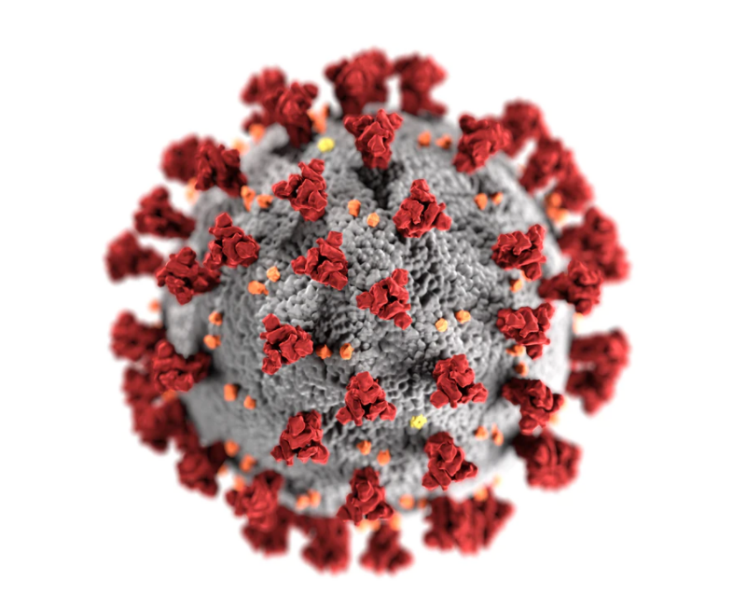

COVID19 a Perspective
Akshita Mishra
Mishra.akszita@gmail.com

Slide 2
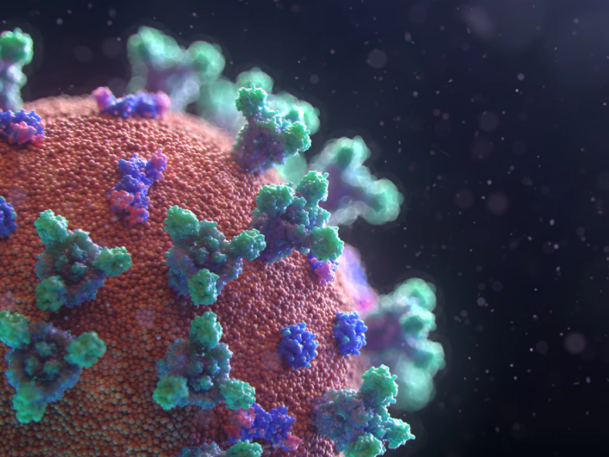
Content
Context and Background
Current Trends and Statistics
Sources of information
Vaccine information
Way forward

Slide 3
Content
Context and Background
Current Trends and Statistics
Sources of information
Vaccine information
Way forward

Slide 4
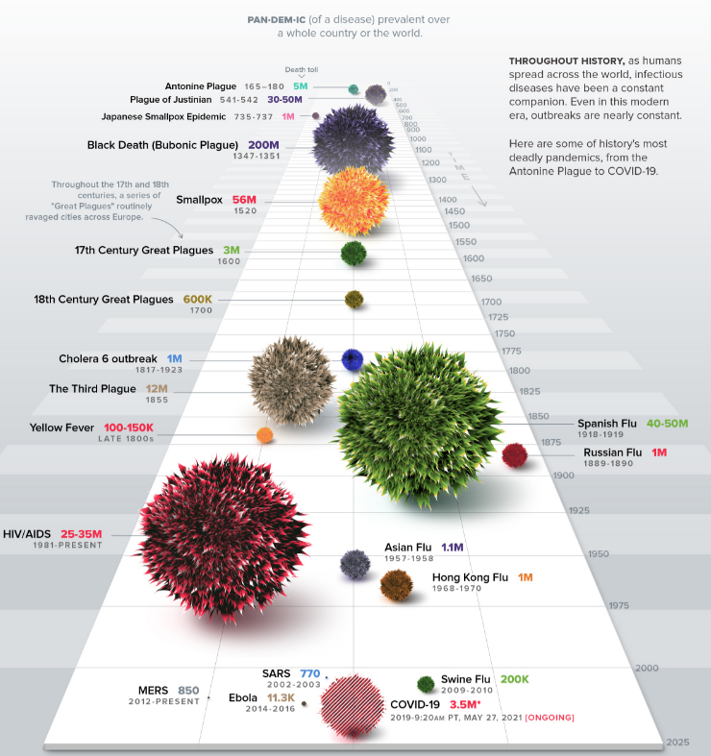
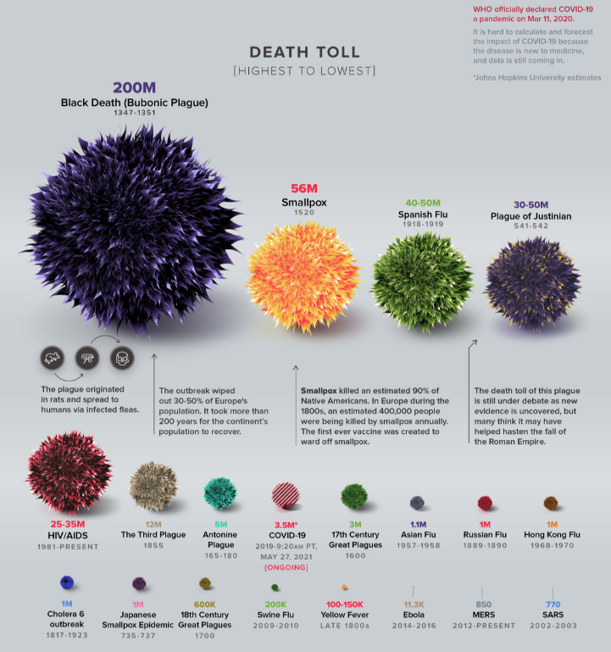
History of pandemics
This chart displays the death toll w.r.t. past historical pandemic events
COVID19 impact still seems relatively smaller compared to other pandemics in the past
Source: Visual Capitalist
Notes:
Source: https://www.visualcapitalist.com/history-of-pandemics-deadliest/

Slide 5
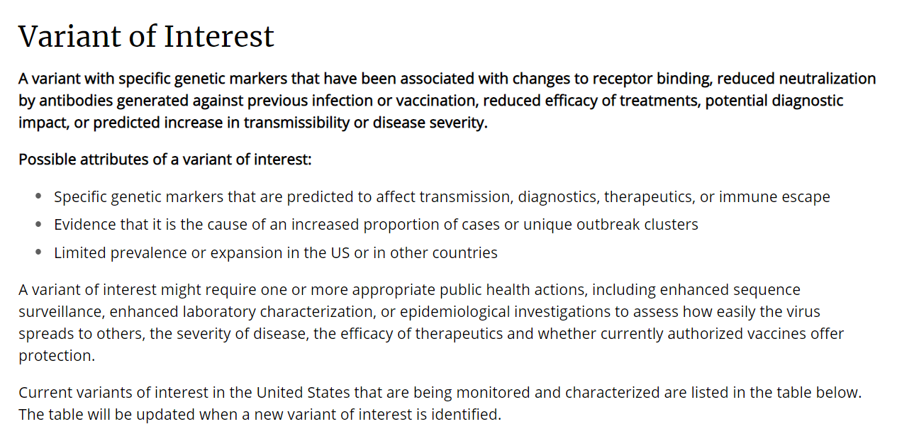
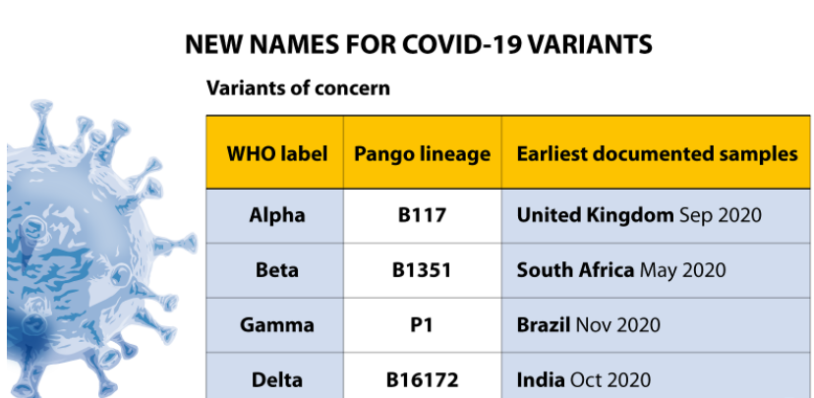
Definition and variants
Definition of COVID-19:
COVID-19 stands for Corona Virus Disease. It is an infectious disease caused by severe acute respiratory syndrome coronavirus 2 (SARS-CoV-2). The disease was first identified in Wuhan, China in 2019.
SARS-CoV-2 Variants (as of now):
Different variants and classifications around that can be explored in CDC site. Variants of interest are as follows (please refer to CDC site for latest on this):
B.1.526 - First detected in US in Nov2020
B.1.526.1 - US in Oct2020
B.1.525 - UK/Nigeria in Dec2020
P.2 - Brazil in Apr2020
B.1.617 - India in Feb2021
B.1.617.1 - India in Dec2020
B.1.617.2 - India in Dec2020
B.1.617.3 - India in Oct2020
Source: WHO, 31/May/2021
Source: CDC

Slide 6
Content
Context and Background
Current Trends and Statistics
Sources of information
Vaccine information
Way forward

Slide 7
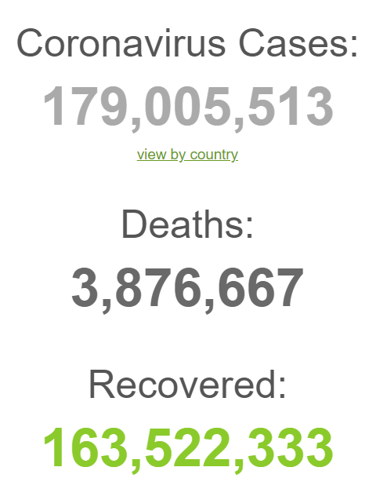
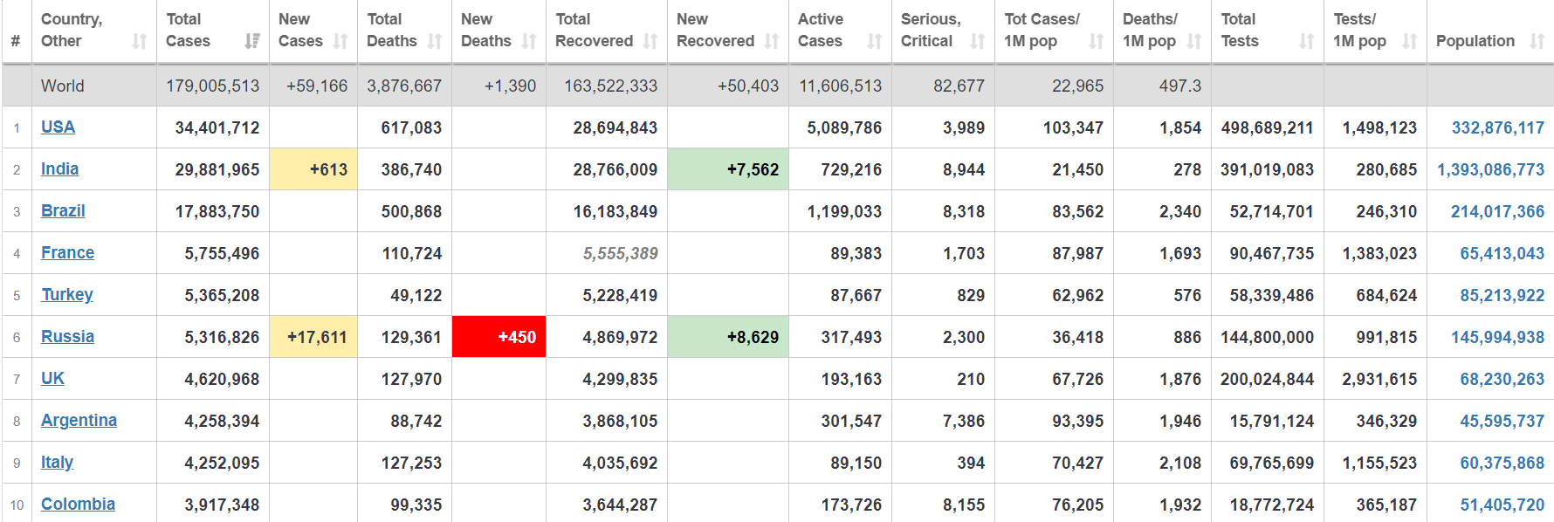
Number of Cases, deaths and Recovered
Top 3 countries accounting for most of the total cases
Data – as of 20/Jun/2021
Source: https://www.worldometers.info/coronavirus/
These are numbers of Top 10 countries in the world as of 20/Jun/2021 based on worldometers report
India’s total case per 1M population is the least compared to Top 10 countries and also below average of world number
P.S: The snapshot of data taken at a certain date/time and they may vary as the time progresses

Slide 8
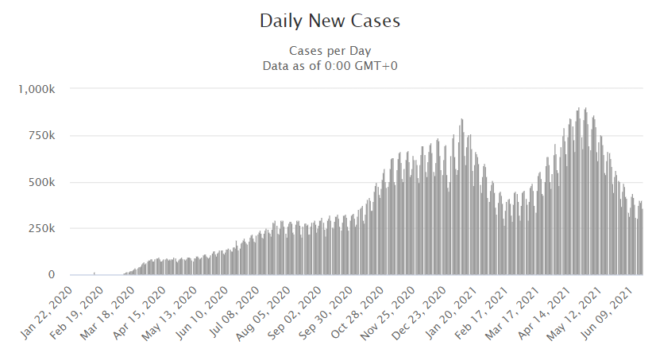
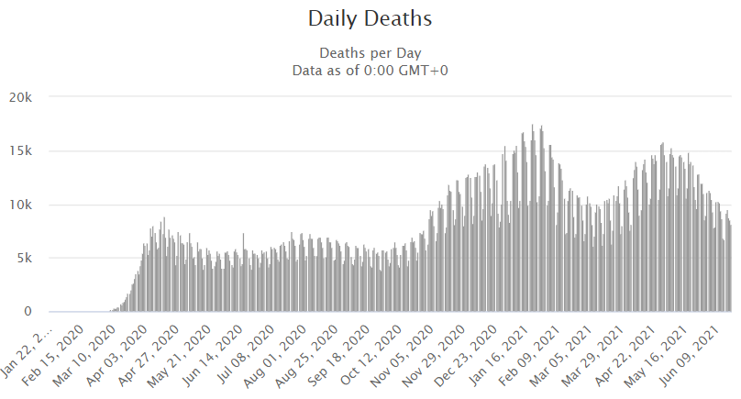
Trends of daily cases, deaths
We can observe few waves based on spikes for number of daily cases as per this chart
We can observe few waves based on spikes for number of daily cases as per this chart
Data – as of 20/Jun/2021
Source: https://www.worldometers.info/coronavirus/
P.S: The snapshot of data taken at a certain date/time and they may vary as the time progresses

Slide 9
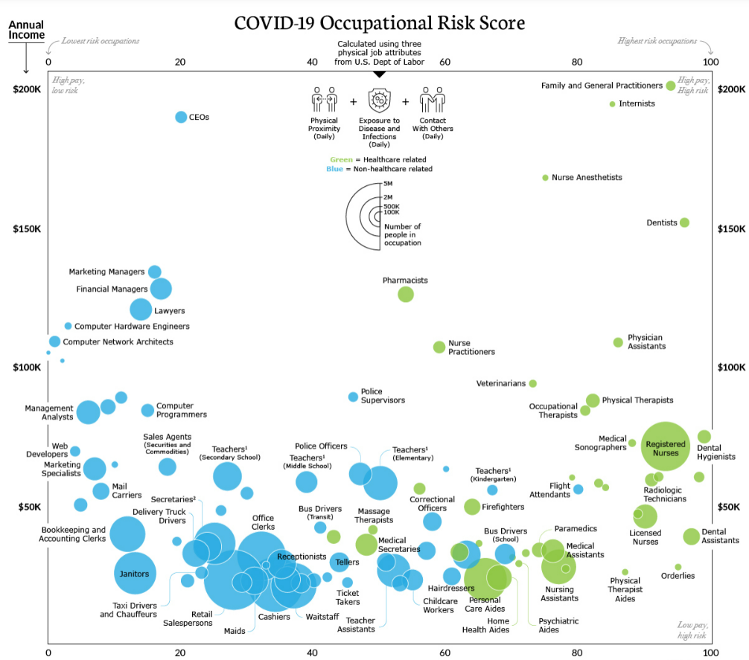
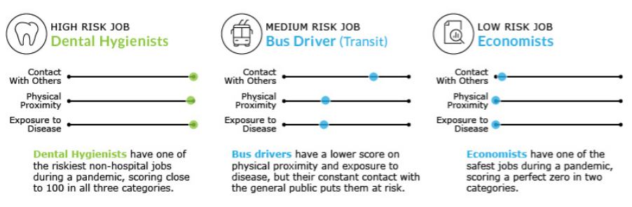
The frontline: visualizing the occupations with high risk
This is computed based on 3 physical job attributes from US Dept of Labor
Physical Proximity (daily)
Exposure to disease & infections (daily)
Contact with others (daily)
Source: Visual Capitalist

Slide 10
Content
Context and Background
Current Trends and Statistics
Sources of information
Vaccine information
Way forward

Slide 11
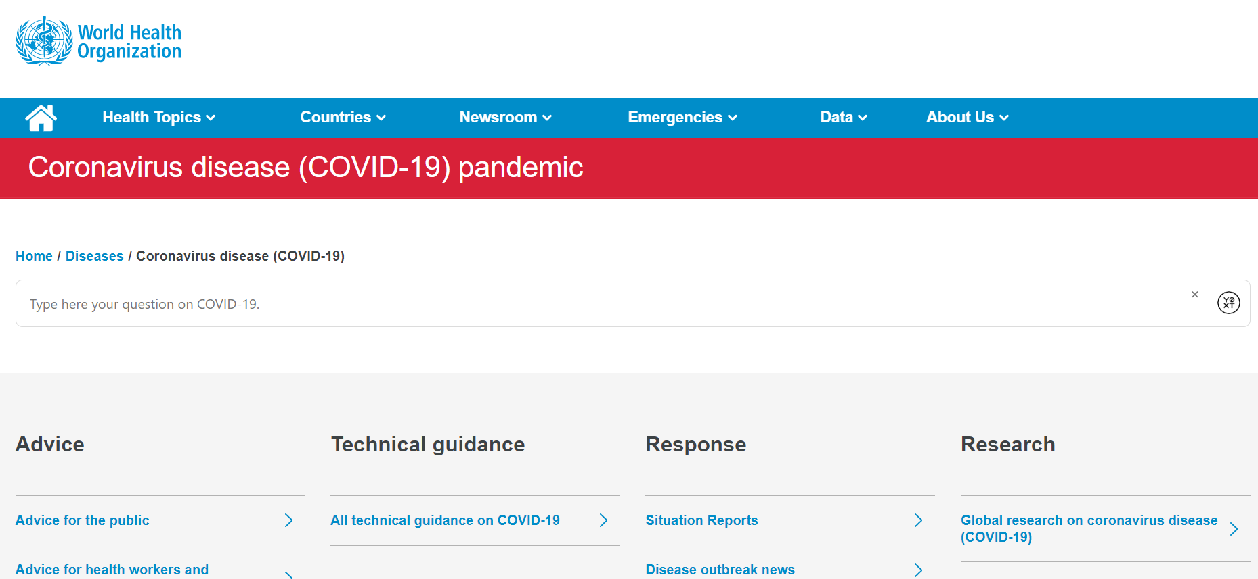
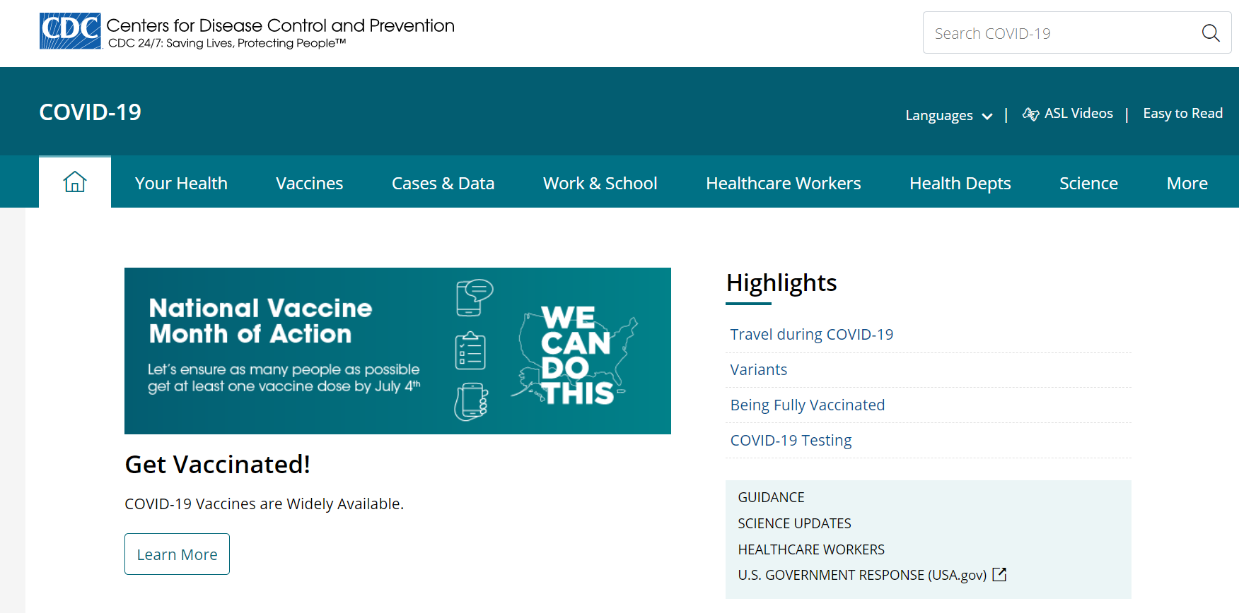
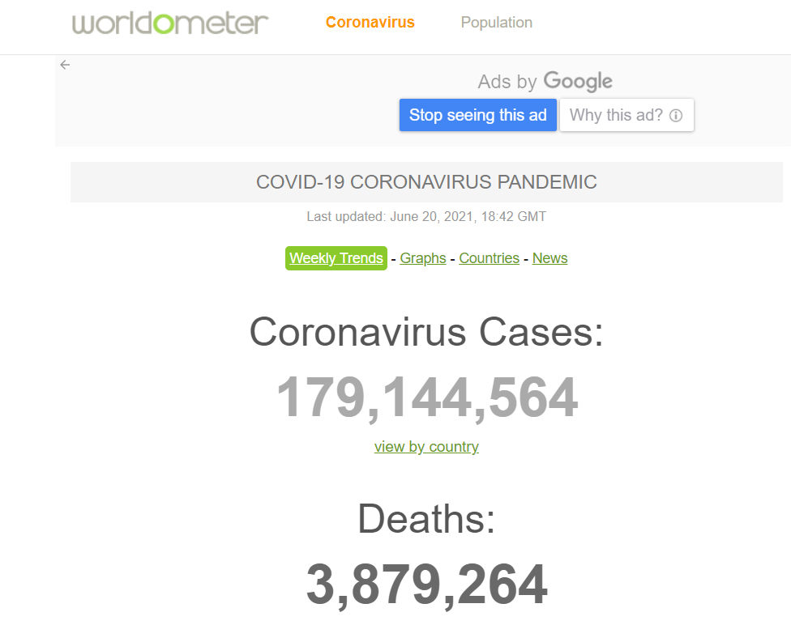
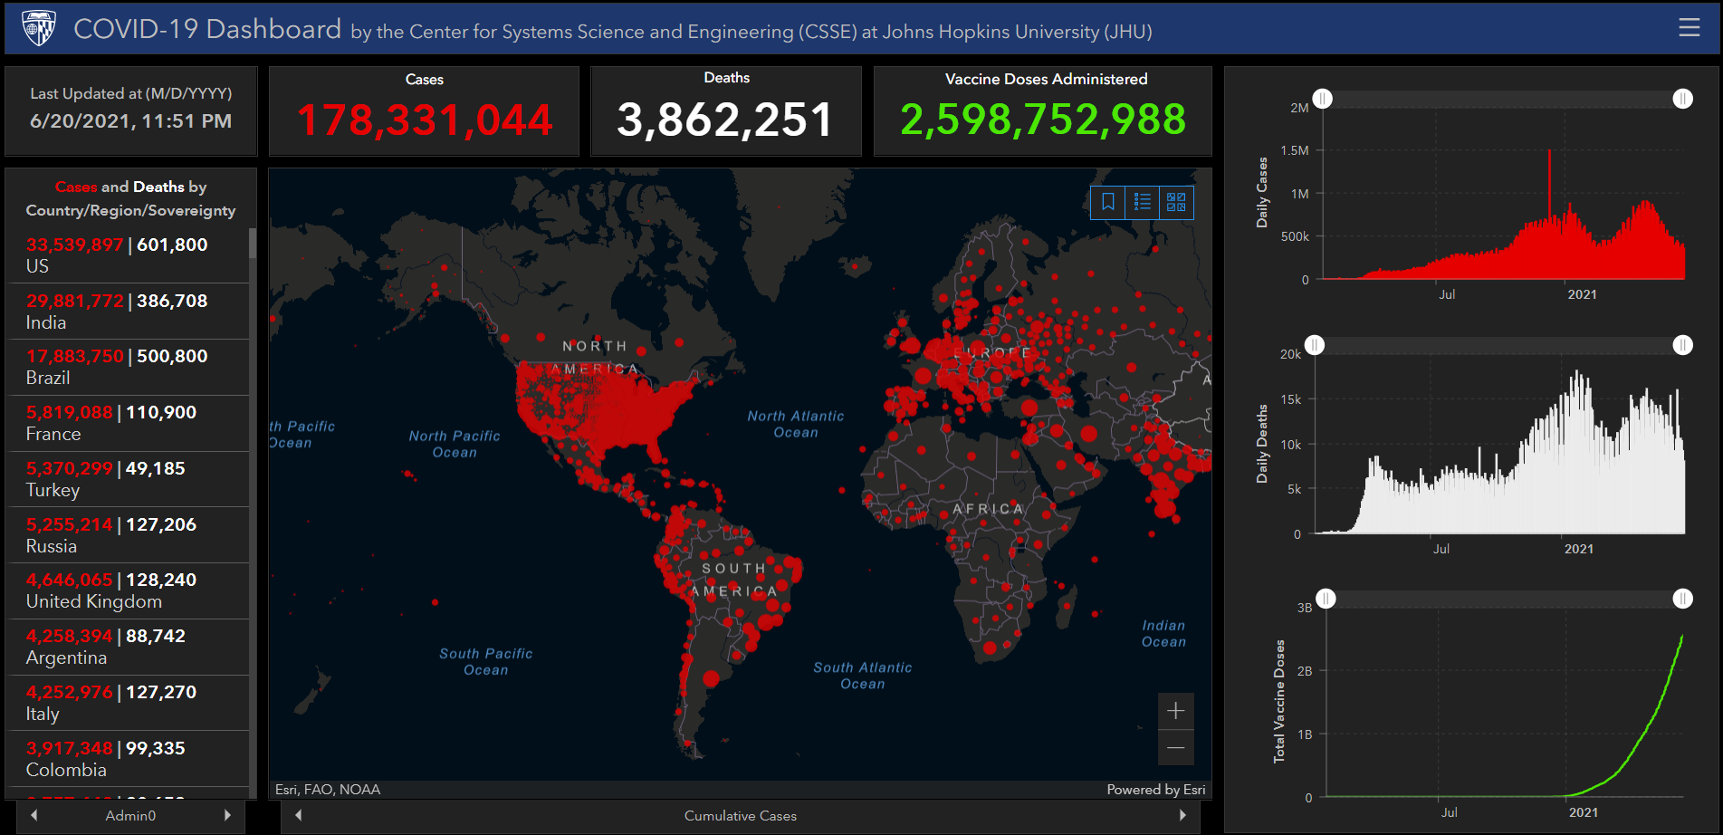
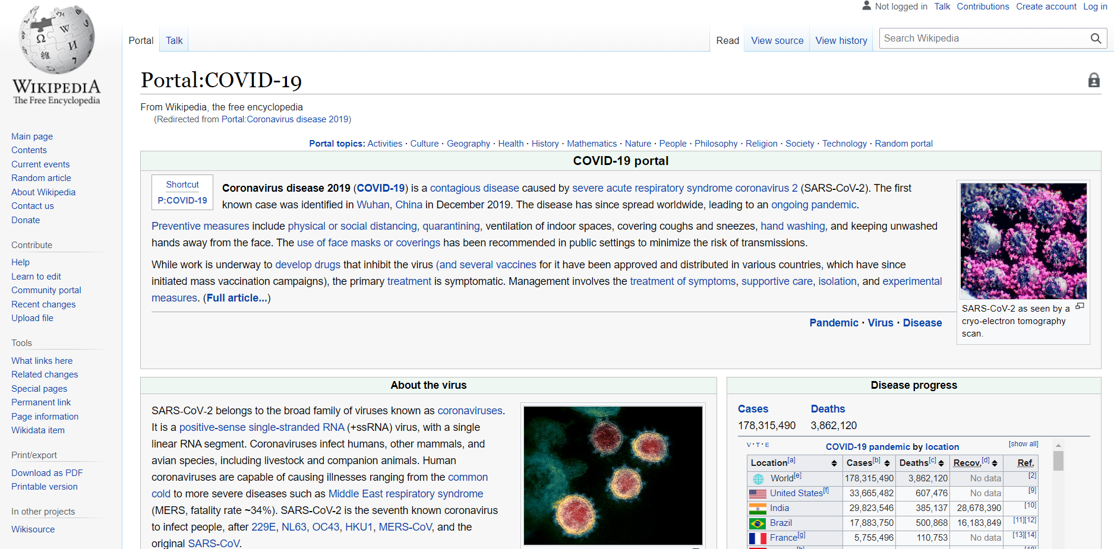
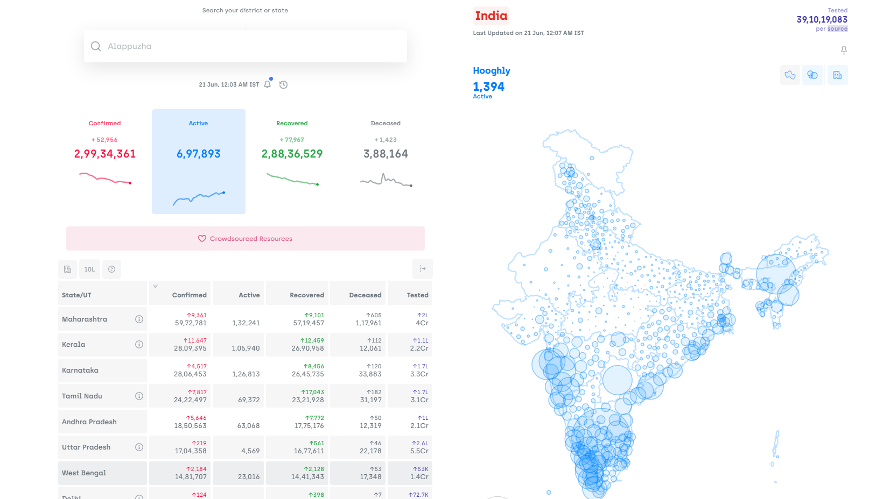
Key sources of information
World Health Organization Site
Center for Disease Control & Prevention
The Worldometer Site
John Hopkins University dashboard for COVID19
Wikipedia on COVID19
India specific data
Source: Various key sites of information on COVID19 pandemic

Slide 12
Content
Context and Background
Current Trends and Statistics
Sources of information
Vaccine information
Way forward

Slide 13
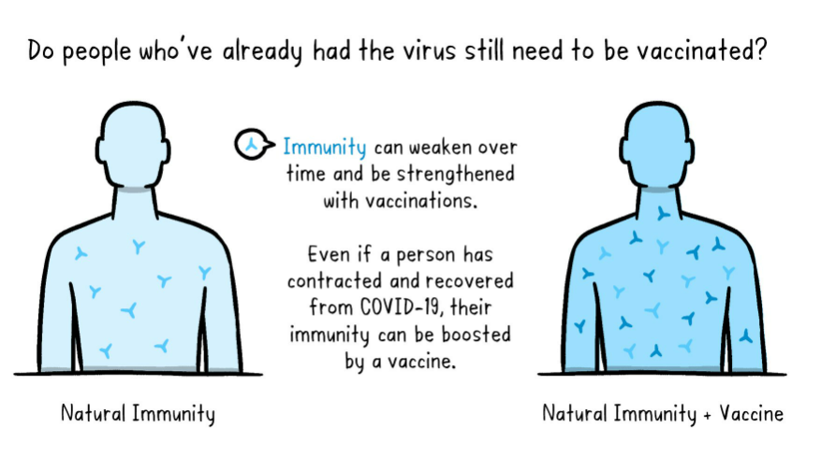
Why vaccination?
“Getting vaccinated is better than getting infected” – WHO (World Health Organization)
Source: WHO

Slide 14
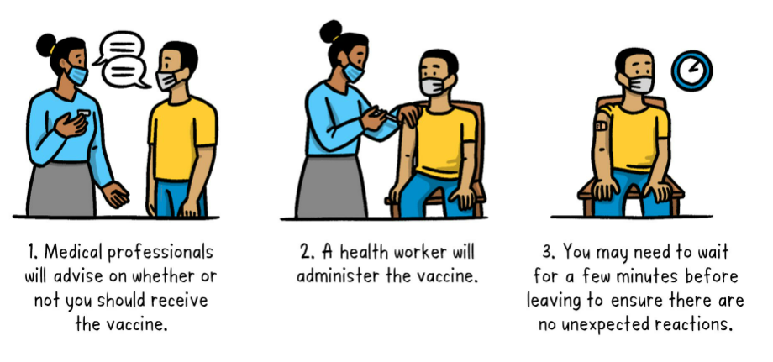
What to expect when getting a vaccine ?
Source: WHO

Slide 15
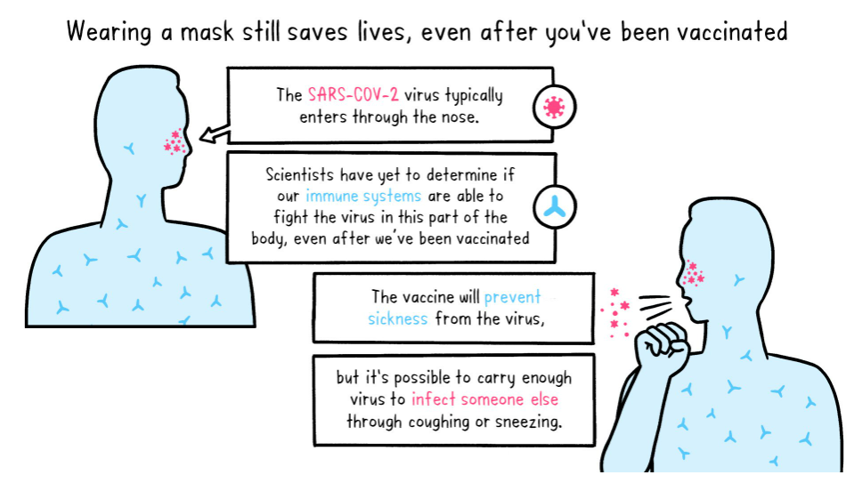
Safety against infection and transmission after vaccination
Source: WHO

Slide 16
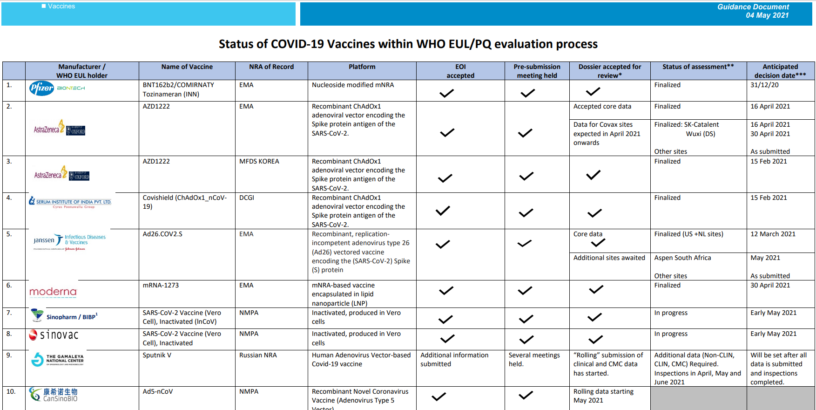
Vaccination information
Vaccination efforts have been started and in progress with tremendous efforts from scientists, researchers across the globe.
Please refer Guidance document on Status of Vaccines within WHO EUL/PQ evaluation process for latest details of vaccines available globally. This gets updated on a regular basis. Please refer to WHO website for the latest on this always.
Source: https://extranet.who.int/pqweb/sites/default/files/documents/Status_COVID_VAX_04May2021.pdf

Slide 17
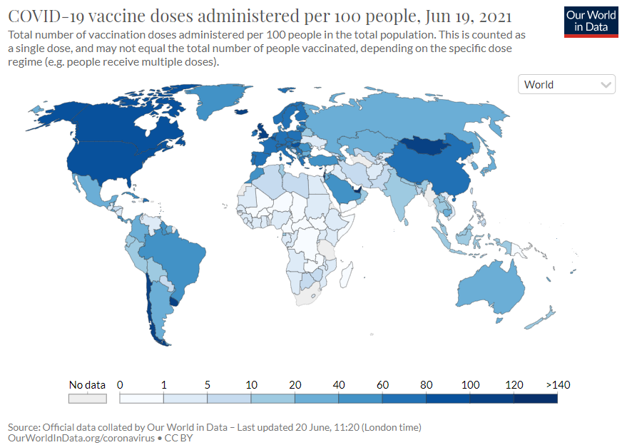
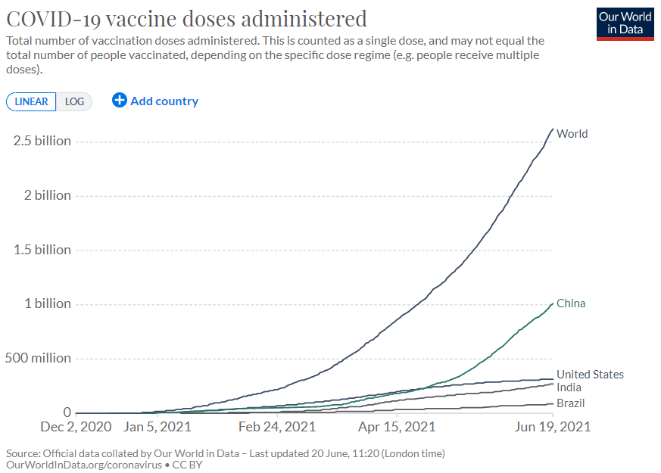
Vaccine doses administered
Almost > 2.5 billion doses of vaccine have been administered across the world. The chart shows for some of the countries such as India, China, United States, Brazil
Source: Our World in Data

Slide 18
Content
Context and Background
Current Trends and Statistics
Sources of information
Vaccine information
Way forward

Slide 19
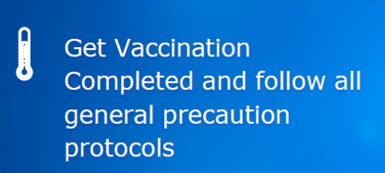
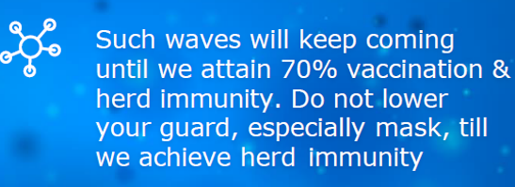
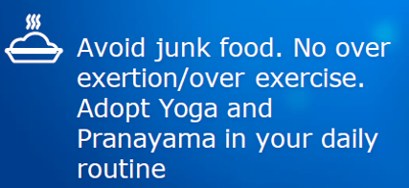
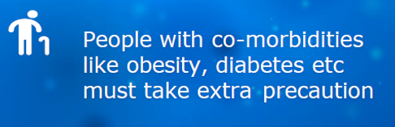
Things to do
We should all follow “Covid19 Appropriate Guidelines” as instructed and suggested by our national/local authorities. We should be able to defeat Corona Virus by taking Vaccine as soon as possible for us whenever we get time to do so and by following “Covid appropriate behavior” always!!

Slide 20
Thank you
Akshita Mishra
GEAR Innovative International School
Email: mishra.akszita@gmail.com
Disclaimer:
The information here are for information or awareness purposes. Please go to respective sites for any authenticity or accuracy or up-to-date information. These are purely my attempt for learning objectives and no way relate to any institute's opinion or any individual’s opinion.

